Slide 1


Cyber
Protect
Data
Threat
Security
Attack
Firewall
Malware
SCAM CRIME SCRIPT ANALYSIS
Using Natural Language Processing
Semester
Project

Slide 2



GROUP MEMBERS
HADIA ALI
410865
AIMEN MUNAWAR
415867
MAHEEN KHAN
429419

Slide 3






TABLE OF CONTENTS
Selected
Research
System
Methodology
Identified
Limitations
Improvement
Evaluation
Conclusion

Slide 4
SELECTED RESEARCH
Supporting Crime Script Analyses of Scams with NLP (2023)
Scam reports are unstructured free-text
narratives
Manual crime-script analysis is time
consuming and resource-intensive
Difficult to systematically identify scam
stages, reason, and intervention points

Slide 5
SELECTED RESEARCH
Objective
Dataset Used
Use Natural Language Processing (NLP) to automatically:
Identify scam reports with similar modus operandi
Extract key terms and sequences
Generate crime scripts that describe how scams unfold
Source: “Scam Alert” website (Singapore)
Content: Victim-submitted reports
Time span: 2016 -> 2020
Final cleaned dataset: 4,554 scam reports
Coverage: 21 scam types

Slide 6
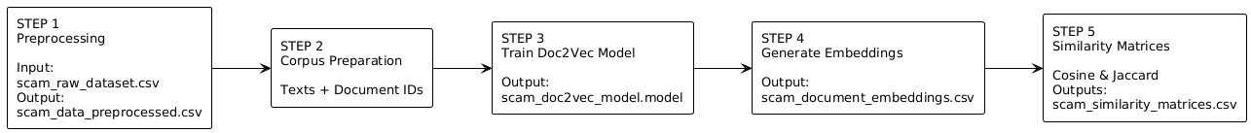
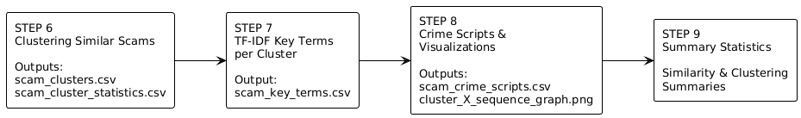
METHODOLOGY

Slide 7
IDENTIFIED
LIMITATIONS
1. Shallow similarity detection:
Jaccard relies on word overlap
and fails with paraphrased scams.
2. Limited semantic representation:
Doc2Vec struggles with short,
noisy reports and misses context.
3. Narrative variability issue:
Semantically similar scams may
be split into separate clusters.
4. Assumed data trustworthiness:
Reports are trusted by default, with
no integrity, or tamper checks.
5. Risk to analysis reliability:
Manipulated or misgrouped reports
can degrade scam scripts and threat
intelligence.

Slide 8
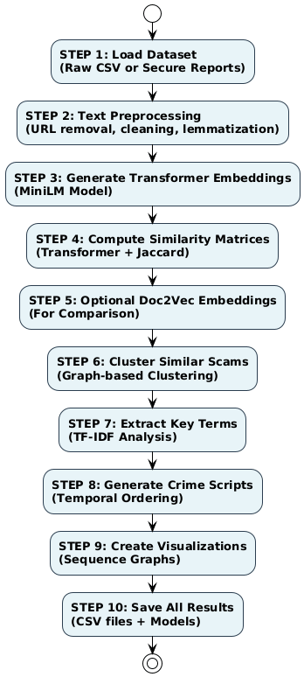
IMPROVEMENTS

Slide 9
SECURITY IMPROVEMENTS
Plaintext reports → secure reports
Reports verified before NLP processing
AES-256 + RSA-OAEP hybrid encryption
SHA-256 + HMAC for integrity
RSA signatures for authentication & non-repudiation
Timestamps + Nounce to prevent replay attacks
Vishing-aware IVs, payload hashing, OAEP labels

Slide 10
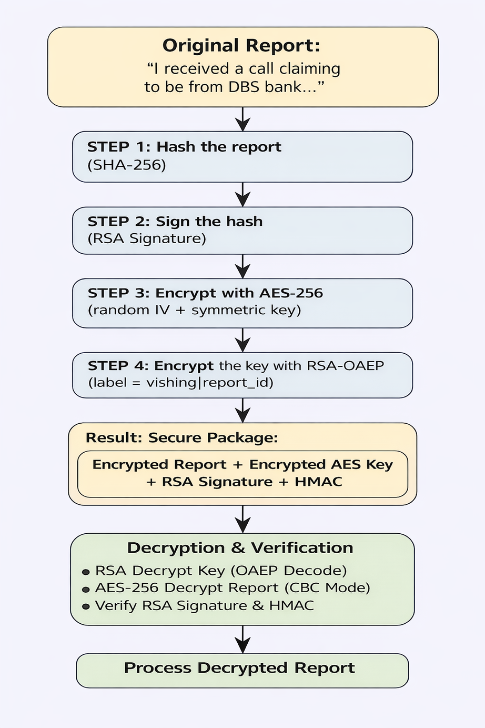
SECURITY IMPROVEMENTS METHODOLOGY

Slide 11
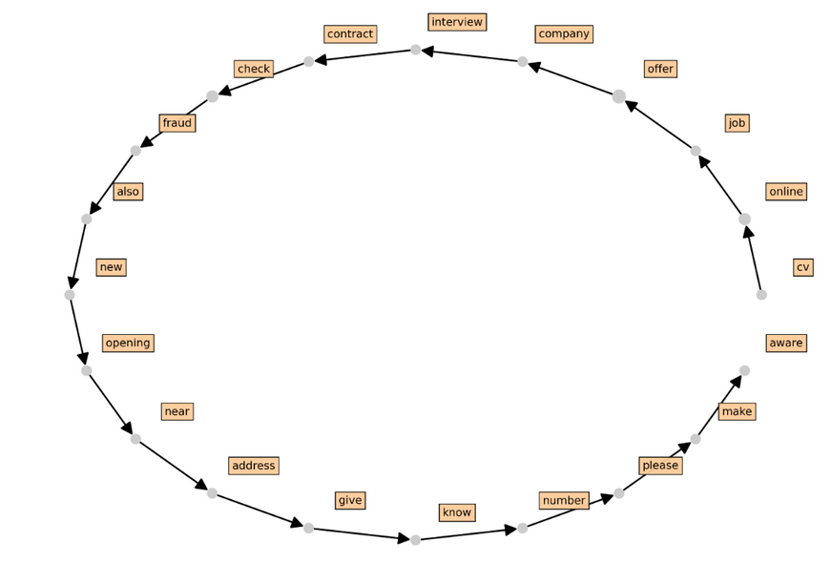
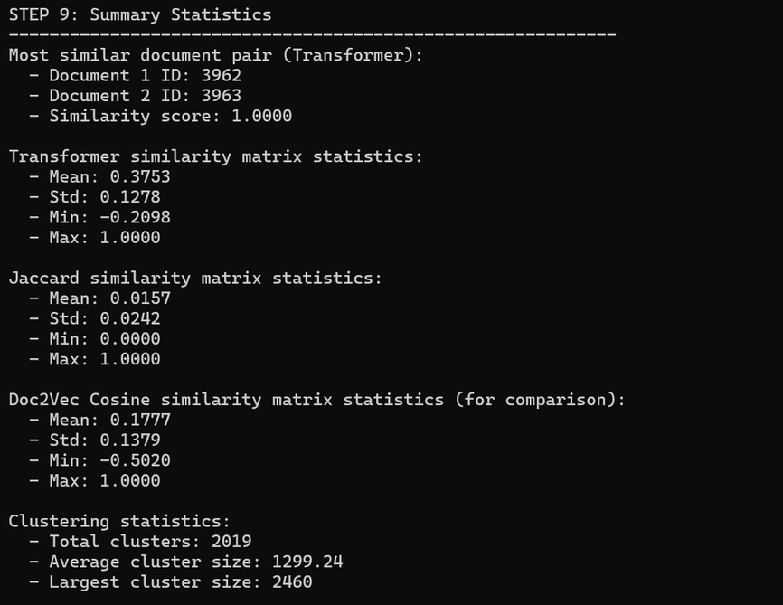
EVALUATION

Slide 12
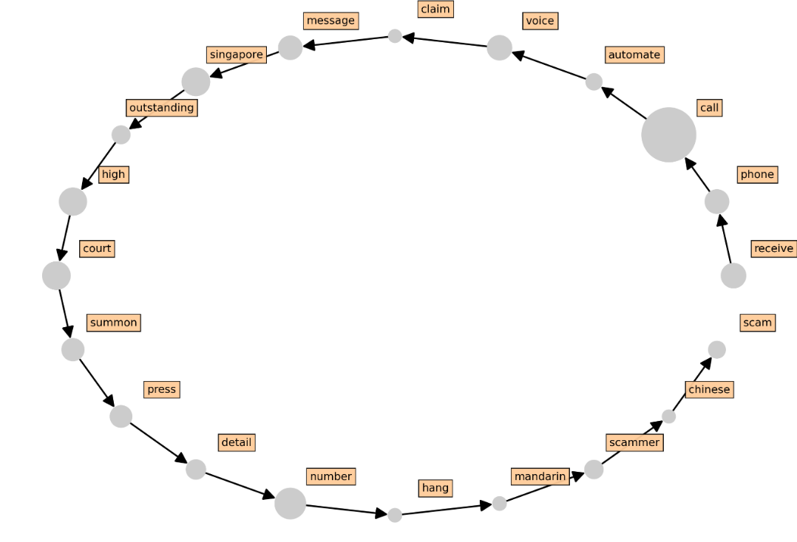
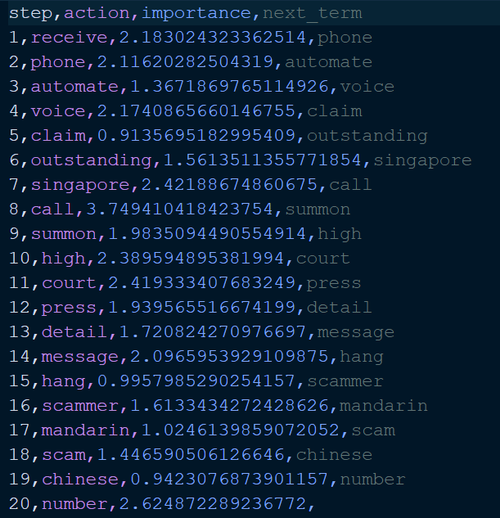
CASE STUDY
I received a scam call. It was an automated voice from the Singapore High Court,
stating that I have an outstanding summon. I was asked to pay it.

Slide 13
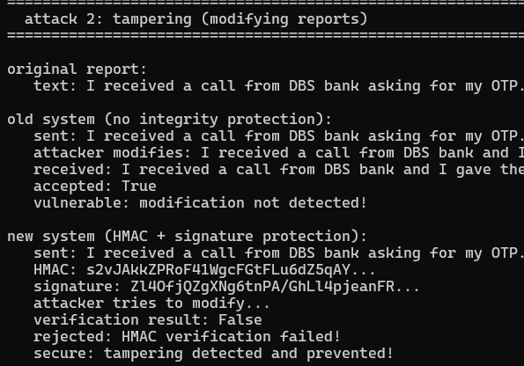
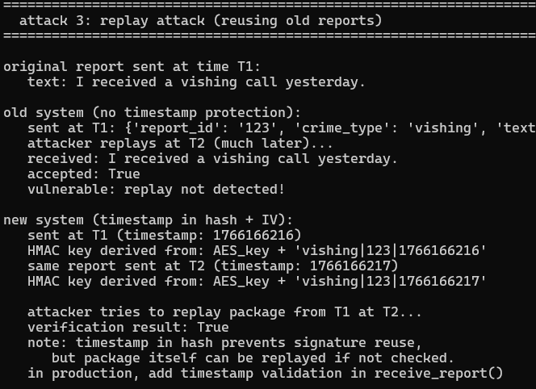
TAMPERING & REPLAY
TAMPERING
REPLAY

Slide 14

CONCLUSION
Successfully reproduced an NLP-based
scam analysis system
Improved semantic similarity using
sentence-transformer embeddings
Ensured trusted input through secure
report transmission and verification

Slide 15


Cyber
Protect
Data
Threat
Security
Attack
Firewall
Malware
THANK YOU!
UNLOCKED

